Slide 1
Mental Health 101,
Psychological First Aid and What to do in a Crisis
2025

Slide 2
Who is SADAG
Founded in 1994 to help patients with Depression and Anxiety Disorders
Telephone Counselling, information and referrals - nationwide
Only Suicide Crisis Line in the country
28+ Helplines that deal with depression, trauma, anxiety, panic, suicide, bipolar disorder, substance use etc.
Available 7 days a week, 365 days a year
Informative material: Brochures, Pamphlets, Posters, Online Resources
Schools Outreach – “Suicide Shouldn’t be a Secret”
Corporate Wellness Events
Rural Community Projects & Community Counselling Containers
Over 160 Free Support Groups around the country

Slide 3


Slide 4

WHAT IS
MENTAL HEALTH

Slide 5



Slide 6
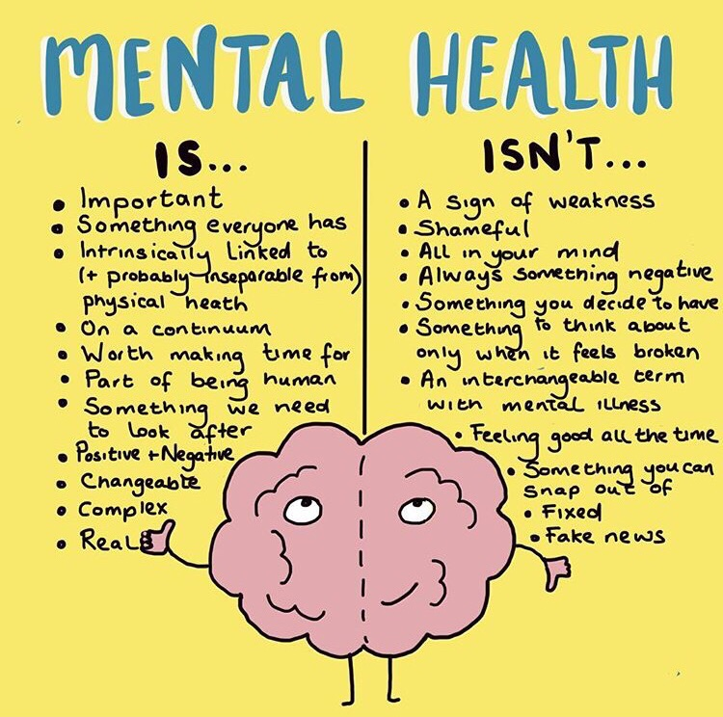

Slide 7

STRESS
What is Stress?
Stress = perceived demands > coping resources
Anything that upsets the body’s natural balance
Forces from the outside world affecting the individual
Stress is part of our lives and, as such, we need to know what causes us to stress and what our symptoms are.
Stress is not always bad
Stress can be exciting and challenging
Stress can help keep us on our toes and perform at our peak
But too much stress can have a negative effect on our bodies, minds and feelings

Slide 8

Who gets Stressed?
Affects people of all ages and all walks of life
No one is free from stress
Degree of stress in our life is dependent upon individual factors such as:
  Physical Health
  Quality of Relationships
  Number of Responsibilities
  Expectations of others and ourselves
  Support Structure
  Number of changes or traumatic events in your life

Slide 9
What Causes Stress?
Relationships:
Difficulty communicating
Unreal expectations – “Live happily ever after”
Feel obligated or under control of others
Loneliness, lack of support
Economic pressure
Extreme demands:
Time pressure
Frustrating situations
Demanding environment
Lack of stimulation
Lack of balance
Work deadlines
Change:
Welcome/happy situations
Unwelcome/traumatic situations
Things that just happen:
Illness
Traffic
Death of a loved one
Unemployment
Things needing action to happen:
Moving
Ending a relationship
Birth of a baby
Tidying cupboards or cleaning out the garage
Changing jobs

Slide 10


Symptoms of Stress
Physical Symptoms
Sleep Disturbances
Muscle Tension
Headache and Migraines
Neck and Back ache
Stomach Problems and Digestive Disturbances
Fatigue or Insomnia

Slide 11

Symptoms of Stress?
Emotional and Behavioural Symptoms
Nervousness
Anxiety
Changes in eating habits – overeating or lack of appetite
Lack of energy
Mood swings
Irritated and snappy
Weepiness and sad
Tired
Lack of concentration and distracted
Lack of performance
Negative thinking and pessimistic

Slide 12

Negative Effects of Stress
Too much stress can Intensify or trigger psychological illness:
Severe anxiety and panic attacks
PTSD
Depression
Substance Abuse
The onset of Mental Health disorders such as Bipolar, Schizophrenia, etc.

Slide 13

Managing Stress?
Think about:
Causes of your stress
Nature of the stress response
Negative effects of stress
Then you can plan a strategy!
Write it down and make a list

Slide 14

Strategies to reduce Stress?
Massage
Meditation
Muscle relaxation
Deep breathing
Physical activity
Play games
Positive self-talk
Read interesting literature
Realize your own limitations
Share your stress – family, friends, support group,
counsellors, social worker, church, helplines
Make a “to-do list” and eliminate “waste-timers”
Time alone
Visualization
Keeping a journal
Yoga and Relaxation Techniques
Walking

Slide 15
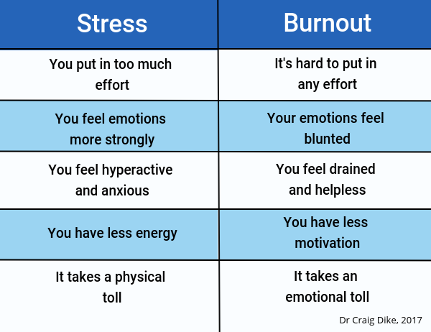
Stress versus Burnout

Slide 16

DEPRESSION
What is Depression?
It is more than just sadness
It is a Mood Disorder and it is treatable
Depression changes the way you feel and think
Without treatment, symptoms can last for weeks, months or even years.
Depression is a common illness (more than 300 million people worldwide are affected)
At its worst Depression can lead to Suicide
Depression affects women more than men (WHO stats) BUT men are 4 times more likely to die by Suicide

Slide 17
Signs of Depression
EMOTIONS – sadness, anxiety, guilt, anger, mood swings, helplessness, hopelessness, overwhelmed, irritability
THOUGHTS – negative self talk, battling to concentrate, struggling to make decisions, confusion, feelings of “What’s the point” or “I want it all to end”, thoughts of suicide or death
PHYSICAL – chronic fatigue, lack of energy, sleeping too much/too little, weight gain or loss, loss of motivation, unexplained aches and pains, headaches, digestive problems, etc.
BEHAVIOUR – crying, quick temper, withdrawal from others, changes in personal appearance, moving very slowly, agitated or unable to settle, snapping/fighting with people around you
IF SYMPTOMS PERSIST FOR LONGER THAN 2-4 WEEKS, THEN IT IS TIME TO SEEK PROFESSIONAL HELP

Slide 18

Causes of Depression
Genetics
Chemical imbalances
Social and Environmental factors
Relationship Issues
Illness
Loss/Grief
Substance Abuse

Slide 19
Risk Factors for Depression
At some point you were depressed before
When you have family members with depression
Perhaps you have tried to die by suicide
Often when there is a lack of social support from family and friends
Perhaps you experienced a stressful or traumatic event (such as abuse, robbery, accident etc)

Slide 20

Why Depression often goes Untreated
Because Patients:
  Don’t see the symptoms in themselves
  Don’t know enough about the illness
  Feel guilty about the symptoms
  Want to avoid the STIGMA
  View depression as a weakness or failure
  Have no support system
  Fail to take all their medication or comply with therapeutic interventions

Slide 21
Self Help for Depression
Knowledge is power – learn as much as you can about the illness
Share your feelings – bottling them up only makes it worse
Increase positive contact
Set small attainable goals
Avoid making life-changing decisions
Don’t be too hard on yourself
Exercise
Diet
Avoid “crutches” – smoking, drinking, drugs
Join a Support Group

Slide 22
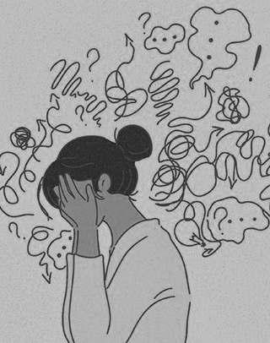
ANXIETY
What is Anxiety?
Characterised by feelings of worry and fear (constant fear)
Natural response of the body to stress (BAD vs GOOD anxiety)
  Triggers/Sources will indicate if its GOOD or BAD
Enduring stress for long periods of time can lead to anxiety, depression
Anxiety can affect one’s daily activities
Constant stress/anxiety can increase fatigue to the point that decision-making is impaired and individuals cannot properly take care of themselves

Slide 23
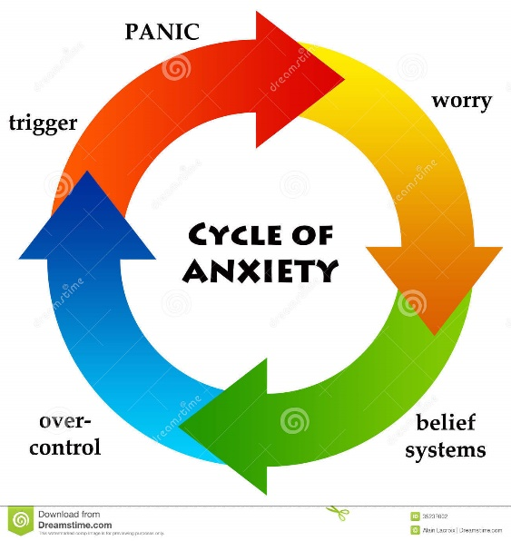
Causes of Anxiety
Individual factors
Extreme demands
Change
Things that just happen
Things needing action to happen
Unwelcomed/traumatic situations

Slide 24
Symptoms of Anxiety
Feeling frightened and scared
Racing heart
Chest pain
Dizziness, feeling light-headed
Nausea
Difficulty breathing
Tingling and numbness in fingers, face and toes
Hot flushes and cold sweats
Feeling disoriented, lack of concentration
Fear of losing control, or doing something embarrassing
Fear of dying

Slide 25
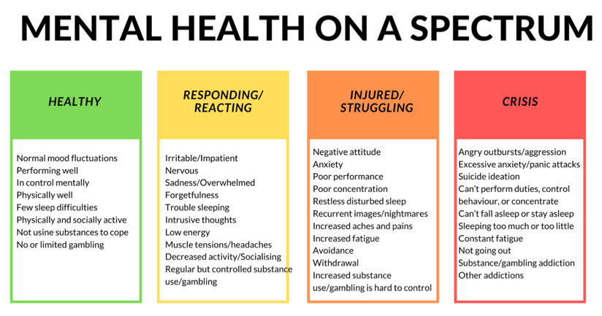

Slide 26

COPING SKILLS & PSYCHOLOGICAL FIRST AID

Slide 27
How To Improve Your Mental Wellbeing
Do mental health check-ins regularly (details on next slide)
Identify your support system/tribe that you can turn to when you need help
Find places you can reach out to if you are struggling
Connect with others and share helpful resources
Share inspirational quotes/songs/pictures to start the week/day – “share the hope”
Ask for help when you aren’t okay
Do things that ‘fill your cup’ daily
  Listen to music
  Get Creative
  Do some physical exercise

Slide 28
Mental Health Check-In
Rate from 1 – 10
Ask yourself “How am I feeling right now?”
Have I eaten? When last did I walk around or stretch? Have I gone outside today?
Body check – physical check in (tense, headache, stiff, heart rate, breathing, etc.)
Take a deep breath
What is taking up most of my headspace right now?

Slide 29
Practical Tips
Promote Positive Coping styles
Negate Negative Coping styles
Self-care tips
De-stressing techniques
Relaxation skills
Sensory coping skills
Emotion coping skills
Bad habits/lifestyle
Comfort eating
Sleeping too much
Over-indulging in legal substances
Using illegal substances
Excessive use of the internet

Slide 30
Self-care Tips
Eat healthy foods
Get enough sleep
Exercise regularly
Practice good hygiene
Take time-out
Positive self-talk
Create an effective balance between work and your personal life

Slide 31

Mindful Minute
Close your eyes & take 1 minute
BREATHE
Take deep breaths in through your nose (4 seconds) and out through your mouth (4 seconds)…and repeat!
LISTEN
Listen to the sounds around you – can you name atleast 5 different sounds?
SEE
Look around you – describe an object around you (shape, size, texture, etc.)
Use your fingertips to touch something near to you – what words would you use to describe it
TOUCH

Slide 32
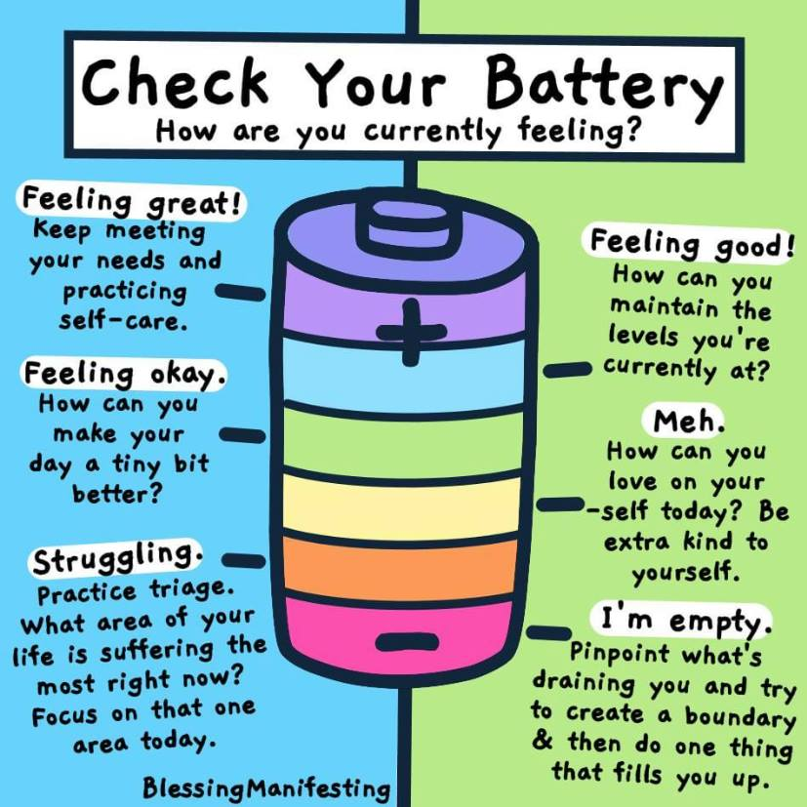

Slide 33
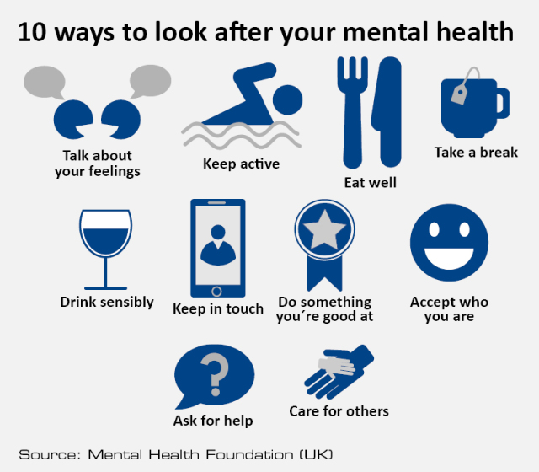

Slide 34

Invest 60 seconds of your day to look after your Mental Health
Get outside
Do some Activity
Mindfulness exercise
Connect
Reflect – gratitude
Helping others
Talk
Breathe
Fill up your energy
Planning/organise

Slide 35
HOW TO HELP SOMEONE IN NEED

Slide 36
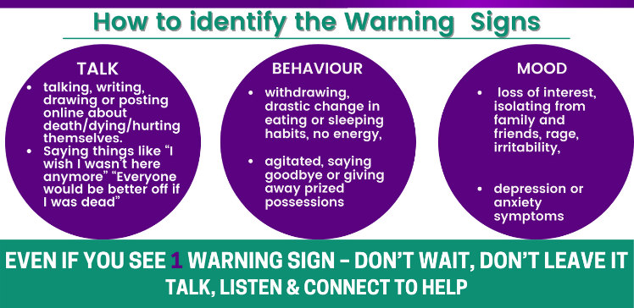

Slide 37



What to do
Start conversations
  “How are you really doing today”
  “How are you really feeling now”
Share resources
Share self help tips
Encourage people to get help and support
Connect
Speak to someone
Build support system
Get professional help
Employee Assistance Programs (EAP)
Free Counselling
Support Groups
Local Hospitals and Clinics
NGOs
Churches
Lead by example
“You can't pour from an empty cup”
Looking after yourself helps you to look after others
Invest in your mental health
Encourage your colleagues, team, friends to look after their mental health too
Learn more

Slide 38



Follow these Steps
Ask
Listen
Connect

Slide 39
What NOT to say…
“Think positively”
“Pull yourself towards yourself and get on with it”
“Just get over it”
“Don’t think about it”
“Snap out of it”
“It’s all in your mind”
“Just do some exercise and you will feel better”
“But you everything to be grateful for. There are other people will far less”

Slide 40
What to say…
“I am here to support you if you need it”
“I might not know exactly how you are feeling, but I am here for you”
“I am sure this feels scary and overwhelming. I am here and I want to help you”
“You’re not alone, help me understand what you’re feeling”
“Together lets see what support we can get”
“I am here to listen. What can I do to help?”

Slide 41

RESOURCES

Slide 42

MENTAL HEALTH RESOURCES
www.sadag.org – videos, brochures, questionnaires, articles, etc.
www.thoughtsfirst.com – podcasts, mindfulness
www.nami.org
www.nimh.org
www.beyondblue.org.au
www.mind.org.uk
Calm app
MoodFit app
Headspace - meditation
Griefshare
Psych Central – online forums
Weekly SADAG Facebook Friday Expert Q&A

Slide 43
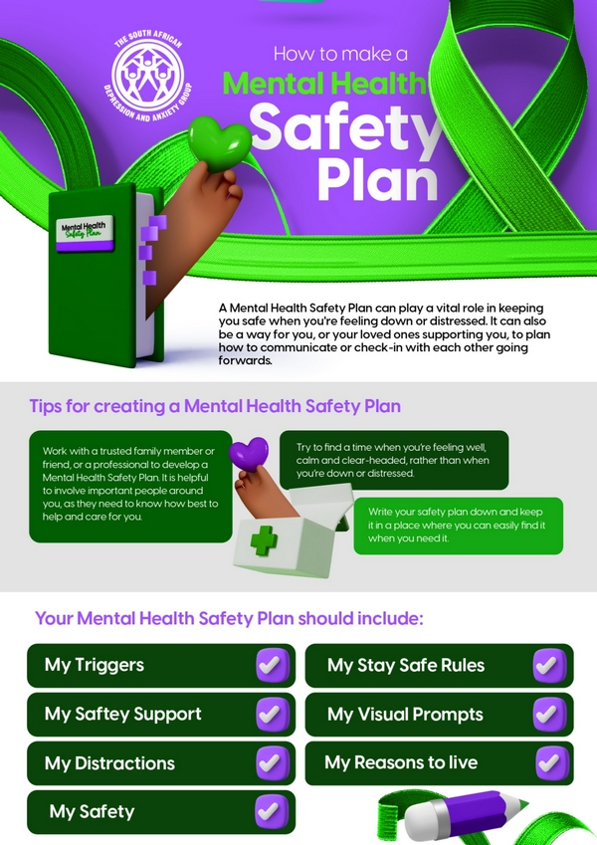

Slide 44
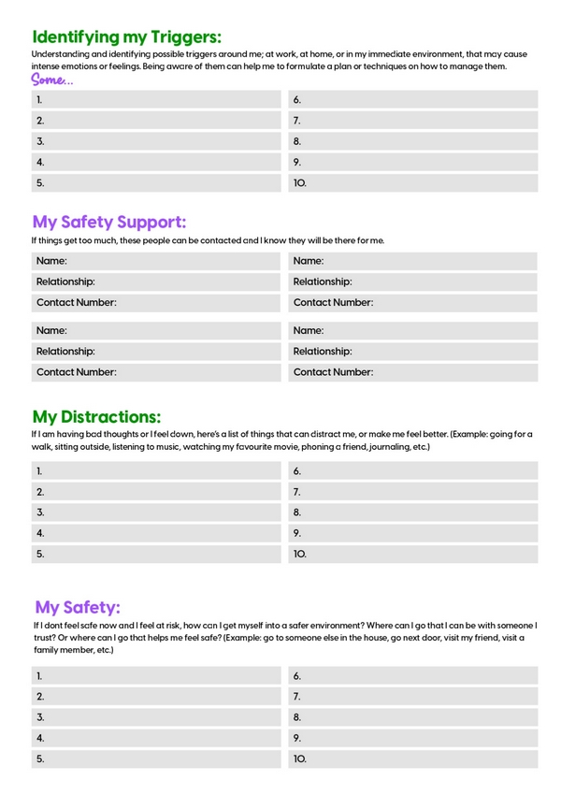

Slide 45
How SADAG can help in an Emergency
Crisis intervention
Speaking to the student
Assisting and guiding
Referrals to doctors, hospitals and counselling
Case management

Slide 46


